Slide 1
Regulation of the arterial BP
short term regulation
long-term regulation
Works within seconds or minutes
baroreceptor mechanism
Works within hours, days ,weeks or years
the rennin –angiotensin-Aldosteron system
Notes:
Regulation of the arterial BP:
2 types of regulatory mechanisms:-
1. acute regulatory mechanism.:- (short term regulation)
this mechanism works to regulate the B.P. within seconds or minutes . & it is the (baroreceptor mechanism).
2.chronic control of B.P (long-term regulation )
this mechanism works within hours, days ,weeks or years. & it is called (the renin –angiotensin. Aldosteron system).

Slide 2
Baroreceptor mechanism
Baroreceptors
high pressure receptors
Low pressure receptors
Right atria
Left atria
pulmonary veins
carotid sinus
aortic arch
Notes:
Baroreceptors :
a. high pressure receptors (arterial receptors)
They are stretch receptors that located in the adventitia of the vessels.; they are stimulated when stretched. Baroreceptors are extremely abundant in
(1) the wall of each internal carotid artery slightly above the carotid bifurcation, an area known as the carotid sinus
(2) the wall of the aortic arch.
b. low pressure receptors (cardio pulmonary receptors): in the wall of the right, left atria & in the pulmonary veins

Slide 3
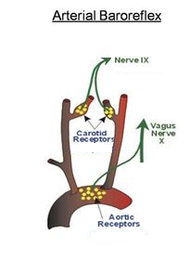
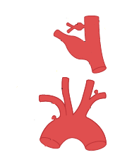
carotid body
Int carotid A
Ext carotid A
carotid sinus
Common carotid A
Aortic body
Aortic arch
Notes:
Signals from the “carotid baroreceptors” are transmitted through very small hering’s nerves to the glossopharyngeal nerves and then to the tractus solitarius in the medulla oblongata.
Signals from the “aortic baroreceptors” in the arch of the aorta are transmitted through the vagus nerves also to the sameTractus solitarius of the medulla.

Slide 4
Mechanism of transduction
AP
Stretch receptor
stretch activated Na channels
Notes:
Mechanism of transduction Stretching of the wall of the blood vessels (example by an increasing level of blood pressure) causes stretching of the baroreceptors which contain stretch activated Na channels. With opening of these channels sodium ion move from the extracellular to intracellular fluid of the baroreceptors causing depolarization . So the rate of discharging of the baroreceptors will increases.

Slide 5
Reflexes initiated by stretching of the baroreceptors
Glossoph. N
Vagus nerve
NTS
Medulla oblongata
VMC
CIC
CEC
parasymp
Symp to heart
Symp to bl V
Notes:
Reflexes initiated by stretching of the baroreceptors
The baroreceptors are stimulated by distention of the structures in which they are located, and so they discharge at an increased rate when the pressure in these structures rises. Their afferent fibers pass via the glossopharyngeal and vagus nerves to the nucleus of the tractus solitarius in the medulla oblongata. These 2 nerves will inhibit the cardioexcitatory center (C.E.C.) and vasomotor center (VMC) and stimulate the cardioinhibitory center (CIC).
The net effects are
vasodilation of the veins and arterioles throughout the peripheral circulatory system
(2) decreased heart rate and strength of heart contraction.
Therefore, excitation of the baroreceptors by high pressure in the arteries reflexly causes the arterial pressure to decrease because of both a decrease in peripheral resistance and a decrease in cardiac output.
Conversely, low pressure has opposite effects, reflexly causing the pressure to rise back toward normal.

Slide 6
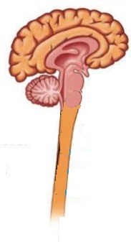
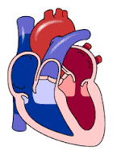
↑rate
Glossoph. N
Medulla oblongata
Vagus nerve
Cardiorequlatory center & VMC
Vagus nerve
↑rate
parasymp
Symp n
↓rate
Symp chain
Blood vessels
Notes:
At normal blood pressure→Basal discharge (tonic discharge), so both CEC & CIC act but in balance this mean that all time (in basal discharge ) there is A.P. found in the vagus, glossopharyngeal n.& in sympathetic, parasympathetic of CEC & CIC
↑↓ BP→↑↓ Basal discharge
↑MABP→↑stretching on both sinuses→↑ impulses from the receptores→inhibition of CEC and VMC & excitation of CIC (↓force of contraction,↓HR. venodiltation&vasodiltation.
↓MABP.→↓ Stretching→↓ impulses generation→ less inhibition of CEC & VMC &less excitation of CIC. ( ↑force of contraction, tachycardia, venoconstriction & vasoconstriction.)
The baroreceptors respond rapidly to changes in arterial pressure & respond much more to a rapidly changing pressure than to a stationary pressure
In summary, a primary purpose of the arterial baroreceptor system is to reduce the minute by minute variation in arterial pressure

Slide 7
Function of the baroreceptors during changes in body posture.
Standing
↑ BP
pooling of blood in
the lower extremities
↑ C.O.
↑symp outflow.
↓C.O.
↓ baroreceptors discharging rate
↓ BP
Notes:
Function of the baroreceptors during changes in body posture.
Standing results in pooling of blood in the lower extremities and diminished intracardiac blood volume and decreased cardiac output. The resultant arterial hypotension is sensed in the arterial baroreceptors, and afferent fibers from these receptors trigger autonomic signals that increase cardiac rate and contractility and elevate the blood pressure back to normal.

Slide 8
carotid sinus massage
press on the carotid sinus
↑ baroreceptors discharging rate
inhibition of CEC
stimulation of CI.C
↓HR & ↓BP
Notes:
carotid sinus massage :
if we press on the carotid sinus, there will be bradycardia ,↓ blood pressure because the pressure lead to↑ the impulses from its baroreceptors→ inhibition of CEC& stimulation of CI.C. →bradycardia
So this massage can be used to treat tachycardia.

Slide 9
Low-pressure receptors reflexes
Notes:
low-pressure receptors reflexes
Both the atria and the pulmonary arteries have in their walls stretch receptors called low-pressure receptors. They are similar to the baroreceptor stretch receptors of the large systemic arteries.
Even though the low-pressure receptors in the pulmonary artery and in the atria cannot detect the systemic arterial pressure, they do detect simultaneous increases in pressure in the low pressure areas of the circulation caused by increase in volume, and they elicit reflexes parallel to the baroreceptor reflexes to make the total reflex system more potent for control of arterial pressure.

Slide 10
Control of arterial pressure by the carotid & aortic chemoreceptors
carotid body
aortic bodY
Notes:
Control of arterial pressure by the carotid & aortic chemoreceptors (effect of oxygen lack on arterial pressure):
The chemoreceptors are located in the carotid & aortic bodies, & when excited , transmit impulses by nerve fibers pass along with the fibers from the baroreceptors to the vasomotor center.
When the blood pressure is decreased below 80mmHg ,there will be decrease in blood flow to these receptors , which lead to decrease in O2 supply & increase in Co2 &H+ concentration ,so these receptors will send signals to the vasomotor area & stimulate elevation of blood pressure.

Slide 11
Long-term regulation
The rennin – angiotensin – aldosteron system
Lets start the journey

Slide 12
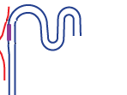
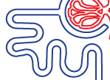
Structure of nephron
Distal convoluted tubules
Glomerulus
Afferent a.a
Bowman's capsule
Collecting duct
efferent a.a
Juxtaglomerular apparatus
Proximal convoluted tubules
Loop of Henle
Notes:
Structure of nephron
The nephron is the basic structural and functional unit of the kidney. Each nephron is composed of 2 parts the "renal corpuscle“ and the "renal tubule“
Renal corpuscle (or Malpighian corpuscle)
is composed of a glomerulus and the Bowman's capsule
Renal tubules
The components of the renal tubules are:
Proximal convoluted tubule
Loop of Henle (U shaped)
Distal convoluted tubule

Slide 13
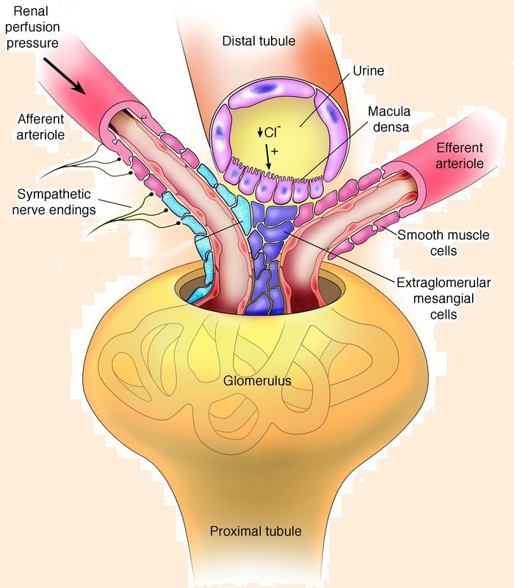
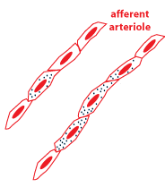
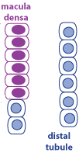
Juxtaglomerular apparatus
Notes:
juxtaglomerular apparatus
Consists from the macula densa, The lacis cells and the juxtaglomerular cells
1. Macula densa
At the point where the afferent arteriole enters the glomerulus and the efferent arteriole leaves it, the tubule of the nephron
touches the arterioles of the glomerulus from which it arose. At this location, which marks the start of the distal convolution,
there is a modified region of tubular epithelium called the macula densa. The macula densa is in close proximity to the JG cells.
2. The juxtaglomerular cells
The JG cells are modified smooth muscle cells located in the walls of the afferent arterioles.
3. lacis cells
are located in the junction between the afferent and efferent arterioles, but its significance in this location is unknown
Renin
Renin is synthesized and stored in an inactive form called prorenin in the juxtaglomerular cells (JG cells) of the kidneys. Renin secretion increases when arteriolar pressure at the level of the JG cells decrease. Another renin-regulating sensor is in the macula densa. Renin secretion increase when the amount of Na+ and Cl– entering the distal renal tubules decreases. Most of the renin enters the renal blood and then passes out of the kidneys to circulate throughout the entire body.

Slide 14
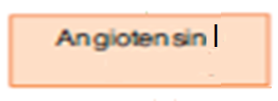
The liver
circulation
Renin
Notes:
Renin acts enzymatically on another plasma protein called angiotensinogen (produced by the liver) to release angiotensin I.

Slide 15
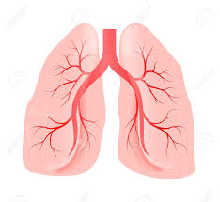
In the lung
00
Angiotensin I
Angiotensin II
ACE
00
Notes:
Within a few seconds to minutes angiotensin I converted to angiotensin II. This conversion occurs almost entirely in the lungs while the blood flows through the small vessels of the lungs, catalyzed by an enzyme called angiotensin converting enzyme that is present in the endothelium of the lung vessels.

Slide 16
Adrenal gland
Adrenal cortex
Z. Glomerulosa
Mineralocorticoids
Mainly aldosteron
Adrenal medulla
Z. Fasiculata
glucocorticoids
Z. Reticularis
androgens
Notes:
The adrenal glands
The adrenal glands are endocrine glands that produce a variety of hormones including adrenaline and the steroids aldosterone and cortisol. They are found above the kidneys The adrenal gland is composed of two parts, the adrenal medulla and the adrenal cortex. The adrenal cortex itself is divided into three zones: zona glomerulosa, the zona fasciculata and the zona reticularis. aldosterone (Mineralocorticoid hormone) produced in the zona glomerulosa help in the regulation of blood pressure and electrolyte balance.

Slide 17
Mechanism of action of aldosterone
Interstitial renal fluid
Tubular lumen
Tubular cell
↑K
K
K
Na-k pump
↓ Na
Na
Na
water
water

Slide 18
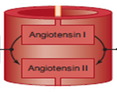
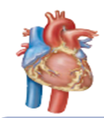
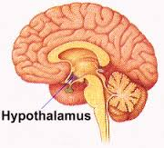
kidney
angiotensinogen
liver
Renin
Angiotensin I
ACE
↑ Na and water reabsor.
Vasoconstriction
Stim. thirst center + Vasopressin
↑ blood volume
↑ BP
Notes:
Angiotensin II has many effects that can elevate arterial pressure.
1. It is one of the most potent vasoconstrictors known, being four to eight times as active as norepinephrine .Vasoconstriction occurs intensely in the arterioles and much less so in the veins. Constriction of the arterioles increases the total peripheral resistance>>>↑DBP. The mild constriction of the veins promotes increased venous return of blood to the heart>> ↑EDV>> ↑SV>> ↑CO>> ↑SBP
2. Angiotensin II causes the adrenal glands to secrete aldosterone, and an important subsequent function of aldosterone
is to cause marked increase in sodium reabsorption by the kidney tubules, thus increasing the total body extracellular fluid sodium. This increased sodium then causes water retention promotes increased venous return of blood to the heart>> ↑EDV>> ↑SV>> ↑CO>> ↑BP.
3. Angiotensin II acts on the hypothalamas and stimulate the thirst center to increase water intake. it also increase the secretion of vasopressin hormone
4. Direct effect on the kidney
Angiotensin II causes consitriction of the efferent arterioles to maintain the GFR
5 Angiotensin II also increases the release of norepinephrine from the postgang. nerve endings >> (vasoconstriction + ↑CO) >> ↑BP

